Slide 1
Pd modeling
Zonghao Hou, Zifan Ding, Hanke Hu, Tong Li

Slide 2

DATA
Visualization
Notes:
啊实打实大苏打

Slide 3
loan_amnt
Mean | 11231.36028
Standard Error | 37.42295482
Median | 10000
Mode | 10000
Standard Deviation | 7464.542832
Sample Variance | 55719399.69
Kurtosis | 0.763136391
Skewness | 1.057864295
Range | 34500
Minimum | 500
Maximum | 35000
Sum | 446850900
Count | 39786
emp_length
Mean | 4.897250289
Standard Error | 0.017703999
Median | 4
Mode | 10
Standard Deviation | 3.531315441
Sample Variance | 12.47018874
Kurtosis | -1.381078502
Skewness | 0.277850033
Range | 10
Minimum | 0
Maximum | 10
Sum | 194842
Count | 39786
annual_inc
Mean | 68979.06676
Standard Error | 319.6694351
Median | 59000
Mode | 60000
Standard Deviation | 63762.63452
Sample Variance | 4065673561
Kurtosis | 2303.219566
Skewness | 30.94133112
Range | 5996000
Minimum | 4000
Maximum | 6000000
Sum | 2744401150
Count | 39786
dti |  | delinq_2yrs
Mean | 13.31779395 | Mean | 0.146533957
Standard Error | 0.033481184 | Standard Error | 0.002465735
Median | 13.41 | Median | 0
Mode | 0 | Mode | 0
Standard Deviation | 6.678300272 | Standard Deviation | 0.491826036
Sample Variance | 44.59969452 | Sample Variance | 0.24189285
Kurtosis | -0.850829816 | Kurtosis | 39.36795255
Skewness | -0.027761063 | Skewness | 5.019746389
Range | 29.99 | Range | 11
Minimum | 0 | Minimum | 0
Maximum | 29.99 | Maximum | 11
Sum | 529861.75 | Sum | 5830
Count | 39786 | Count | 39786
total_acc
Mean | 22.09030815
Standard Error | 0.057161213
Median | 20
Mode | 16
Standard Deviation | 11.40162035
Sample Variance | 129.9969467
Kurtosis | 0.693180045
Skewness | 0.827351918
Range | 88
Minimum | 2
Maximum | 90
Sum | 878885
Count | 39786

Slide 4
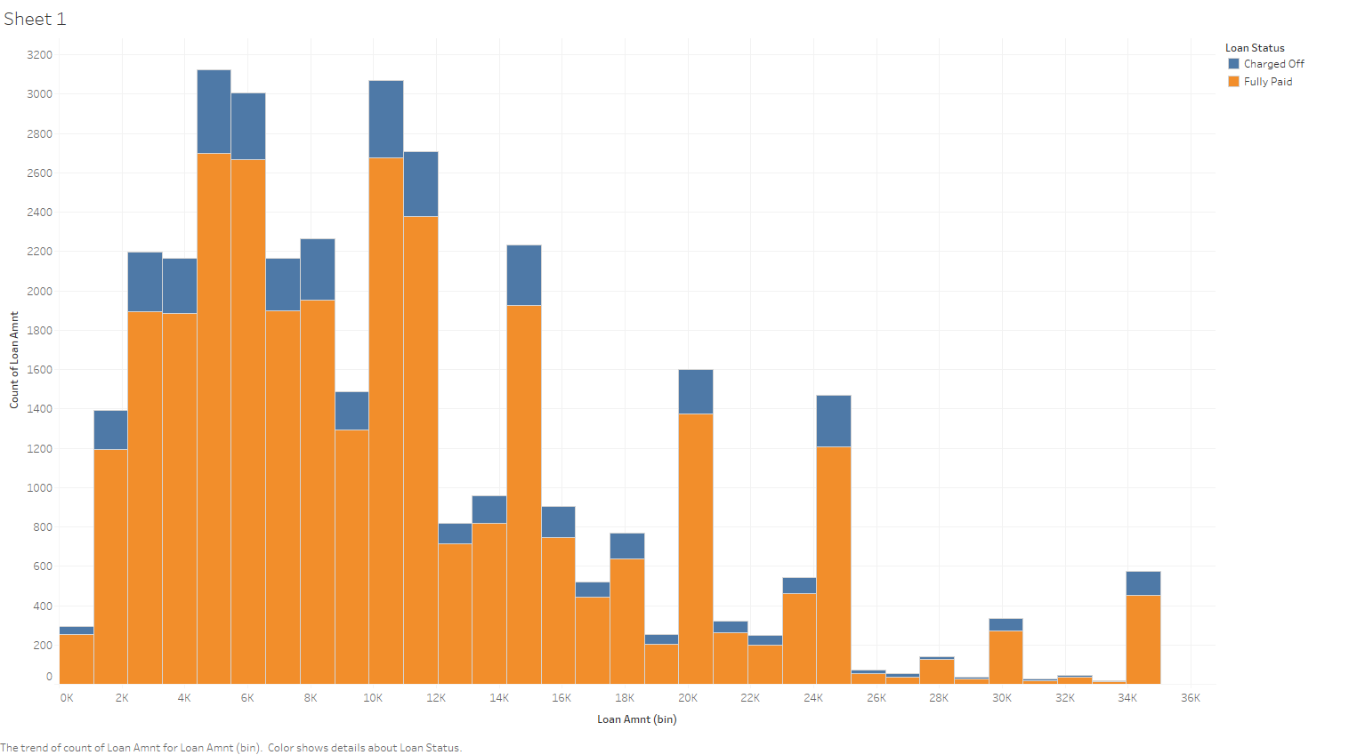

Slide 5
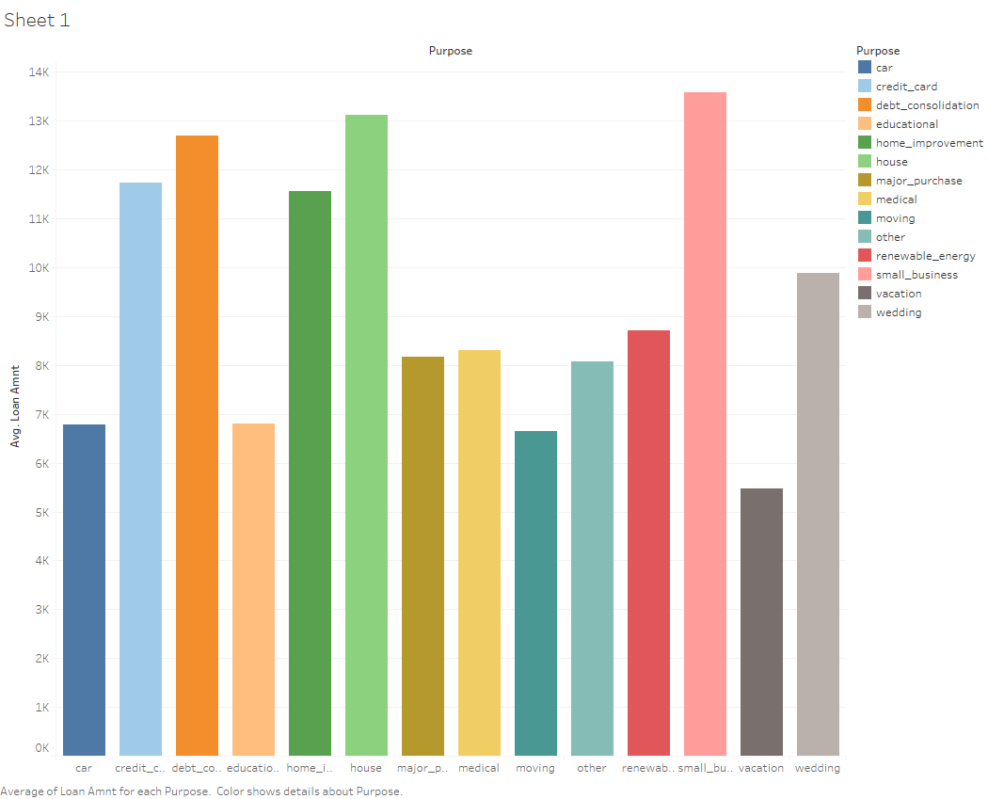

Slide 6
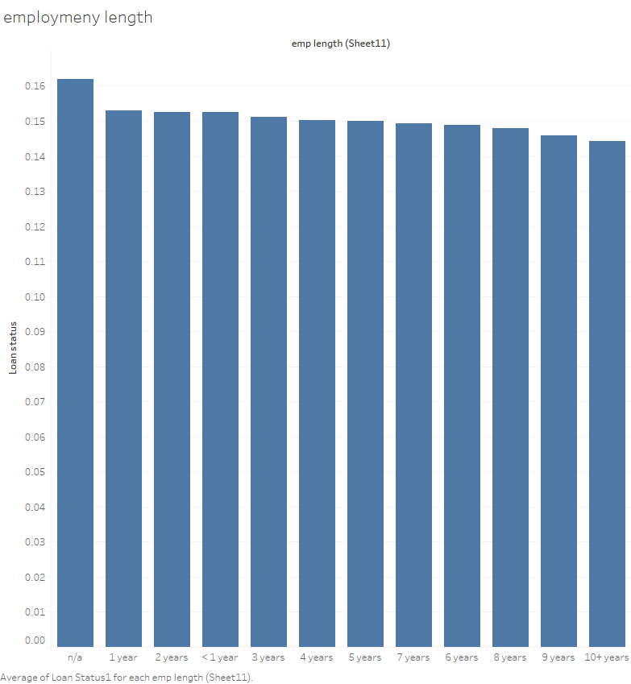

Slide 7
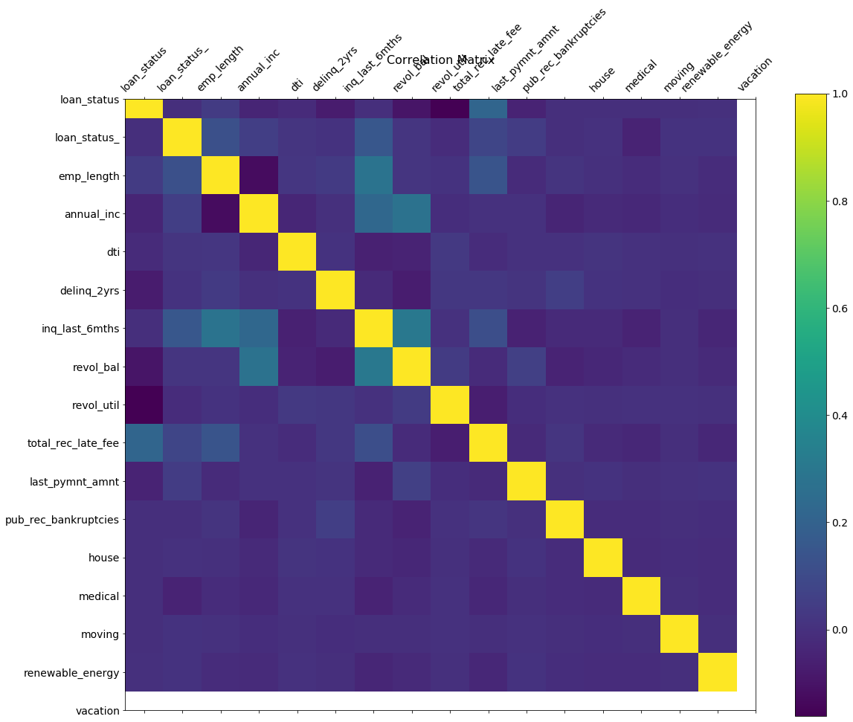
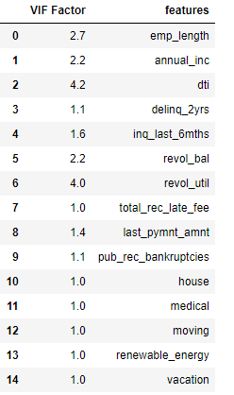
Variable selection

Slide 8
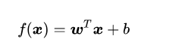
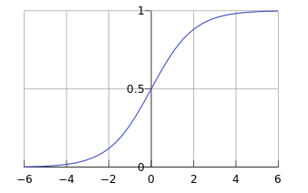
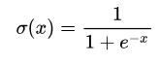
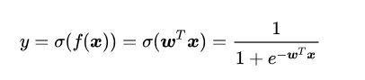
Logistic regression
1. Linear regression
2. Sigmoid function
3. Logistic function

Slide 10
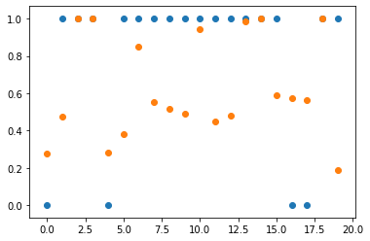
Logistic regression result
Accuracy rate = (483+2474)/(483+2474+937+80) = 74.41%

Slide 11
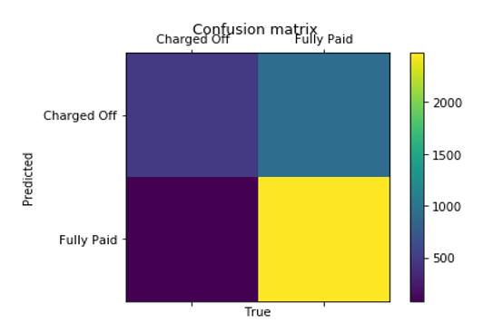
Confusion Matrix
true positives
false positives
483
937
80
2474
true negatives
false negatives
Notes:
We need to summarize how each method performed on the testing data. One way to do this is by creating a confusion matrix for each method.
483 borrowers that default were correctly classified;
2474 borrowers that didn’t default were correctly classified;
However, the algorithm misclassified 80 borrowers that default by saying that they didn’t.
And the algorithm misclassified 937 borrowers that didn’t default by saying that they did.
The number along the diagonal tell us how many times the samples were correctly classified.

Slide 12
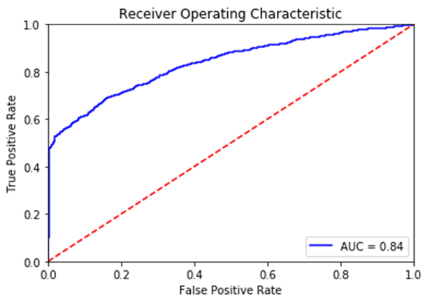
TP
FP
483
937
80
2474
TN
FN

Slide 13

Decision Tree
Food at Home?
Should I cook lunch myself?
Yes
No
Roommates at Home?
Out for lunch
Yes
No
Have classes this afternoon?
Want cooking now?
Yes
No
Yes
No
Out for lunch
Do it!
Out for lunch

Slide 14



Slide 15
Random Forest
Random Features
Random Training Data
Vote

Slide 16
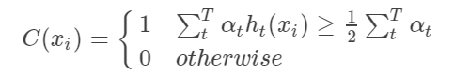
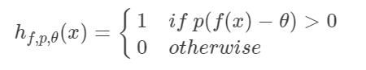
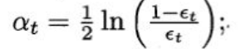




Adaboost
Update Weights $u_{t}$
Strong Classifier $C$
Initialize Weights $u_{0}$
Weak Classifier $H_{i}$

Slide 17
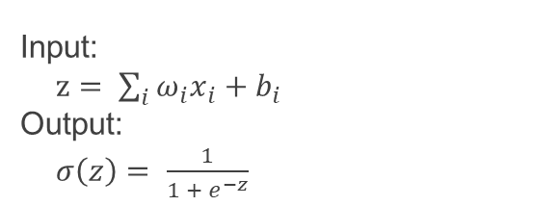
NEURAL NETWORK
Multilayer Perceptron Model (MLP)
Activation function
Sigmoid function
Size : [14, 20, 20, 20, 1]
Input:
$z= \sum_{i}{ω_{i}x_{i}}+b_{i}$
Output:
$σ\left(z\right)= \frac{1}{1 + e^{−z}}$
Outcome
Other alternatives
Accuracy rate : 83.13%
Softmax function
Tanh function
ReLU function

Slide 18
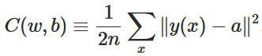
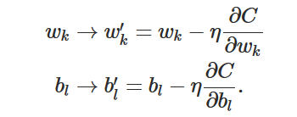
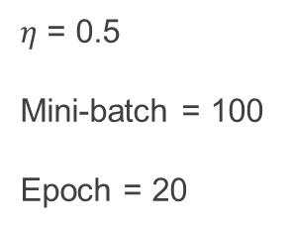
NEURAL NETWORK
Cost function
Gradient descent algorithm
Mean square root(MSE)
Upgrading process :
Other alternatives
$η$ = 0.5
Mini-batch = 100
Epoch = 20
Mean absolute error(MAE)
Sparse categorical cross-entropy

Slide 19
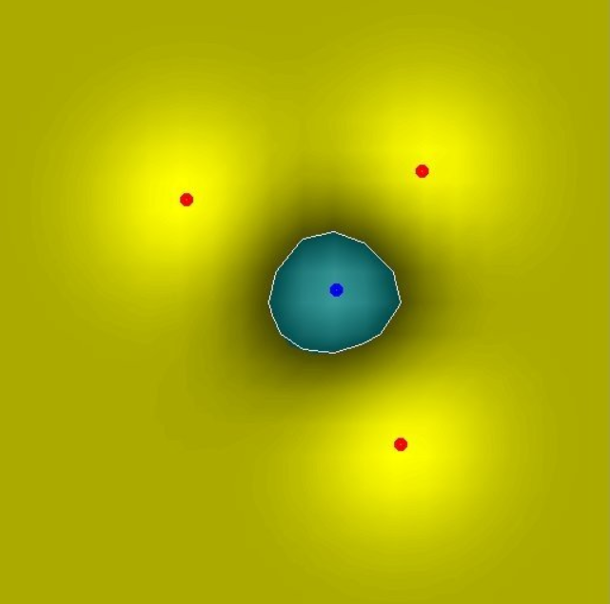
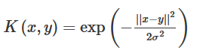
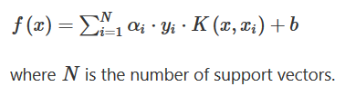

Support vector machine(SVM)
Outcome
Gaussian/RBF kernel function
Accuracy rate :
86.30%
Max-margin SVM formulation
Prediction
$$Y=sign(f\left(x\right))$$

Slide 20
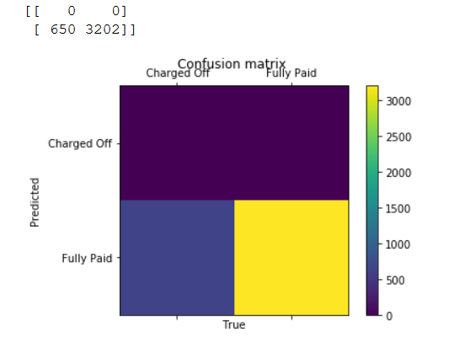
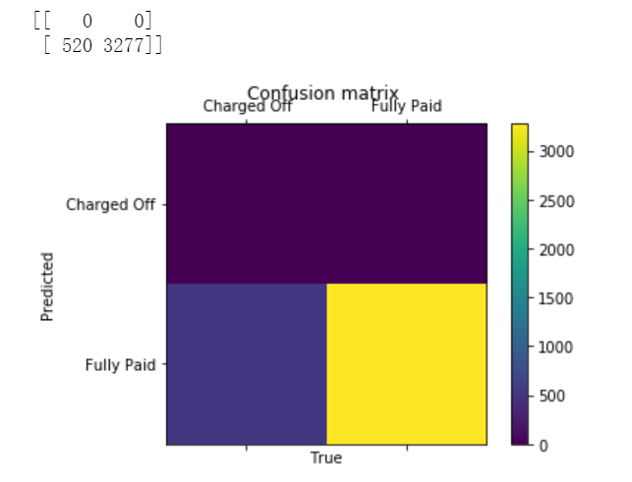
Confusion Matrix
Neural Network
SVM Model
Accuracy ratio:83.13%
Accuracy ratio:86.31%

Slide 21
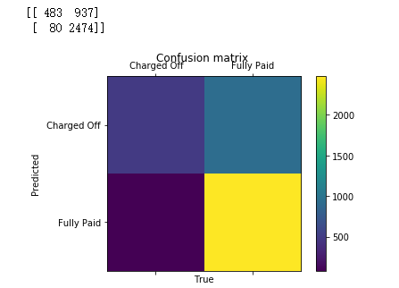
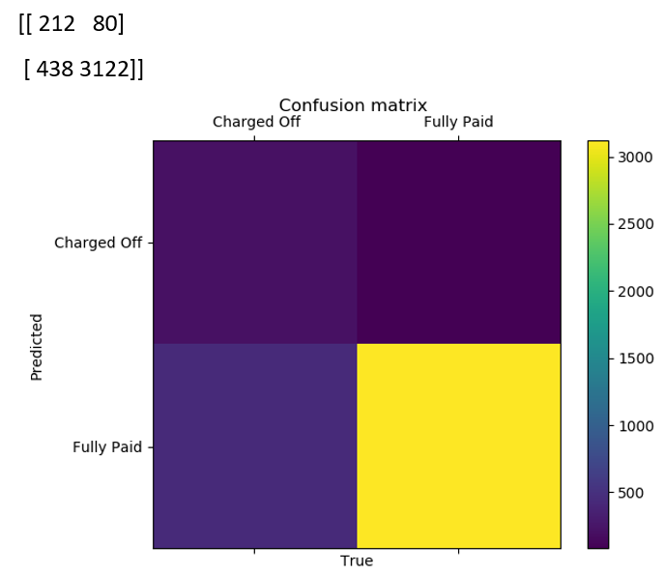
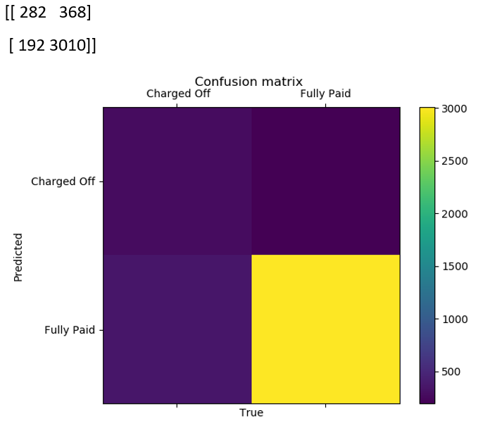
Confusion Matrix
Logistic Regression
Adaboost
Randomforest
Accuracy Ratio | 74.41% | 86.55% | 85.46%
True positive rate | 483/(483+80)=81% | 212/(212+438)=32.62% | 282/(282+192)=59.49%
Notes:
We should focus on true negative rate: when borrowers actually default, how often does it predict default?
483/563 =0.8579;0;0;186/251 = 0.741;165/238 = 0.693
Classification report

Slide 22
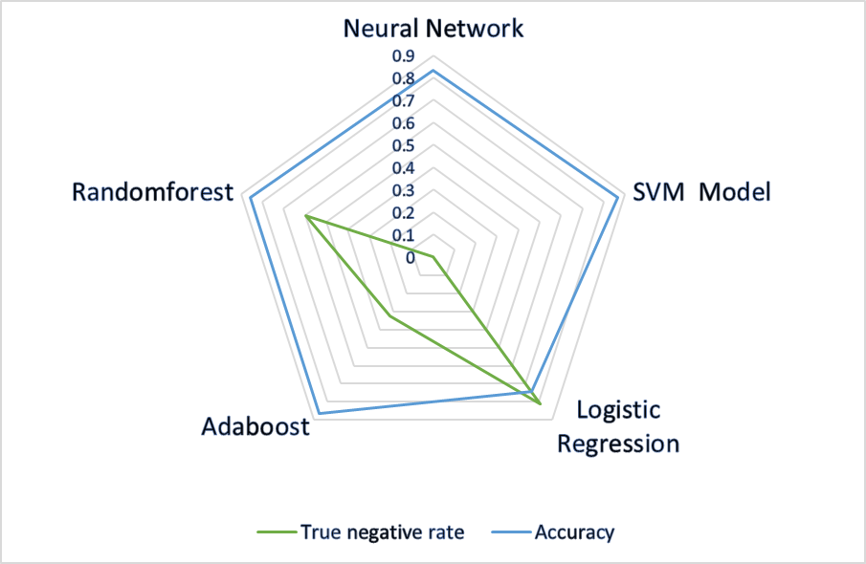
Comparision
Accuracy ratio
Overcome overfitting
Relatively low efficiency
Not easy to explain
Nice interpretability
High True positive rate
Provide default rate data
ROC Graph
Accuracy ratio
Notes:
Logistic regression: It has a nice interpretability, which means it is easy for people to understand the processes it uses to arrive at its outcomes. Logistic regression can also help you understand the contributing factors behind the prediction, and is not just a black box method.
High true negative rate , which is a crucial rate for evaluating the performance of default prediction model.
Random forest:
very clever extension of decision trees, overcome over-fitting
But a Makes them rather inefficient if most of your variables have no or very weak interactions.
Not easy to explain business rules. Because thousands of decision trees.

Slide 23
Conclusion
Notes:
And finally, developing a default prediction model is not just an applied mathematics problem. It depends on real life situation. It requires business sense, and considerable expertise. In solving such problem, being able to combine and balance these is crucial; those who can do this can create the most value and decrease the risk.

Slide 24
THANK YOU

